Slide 2
Topics
Introduction to Inheritance
Polymorphism

Slide 3
Introduction to Inheritance
In the real world, many objects are a specialized version of more general objects
Example: grasshoppers and bees are specialized types of insect
In addition to the general insect characteristics, they have unique characteristics:
Grasshoppers can jump
Bees can sting, make honey, and build hives

Slide 4
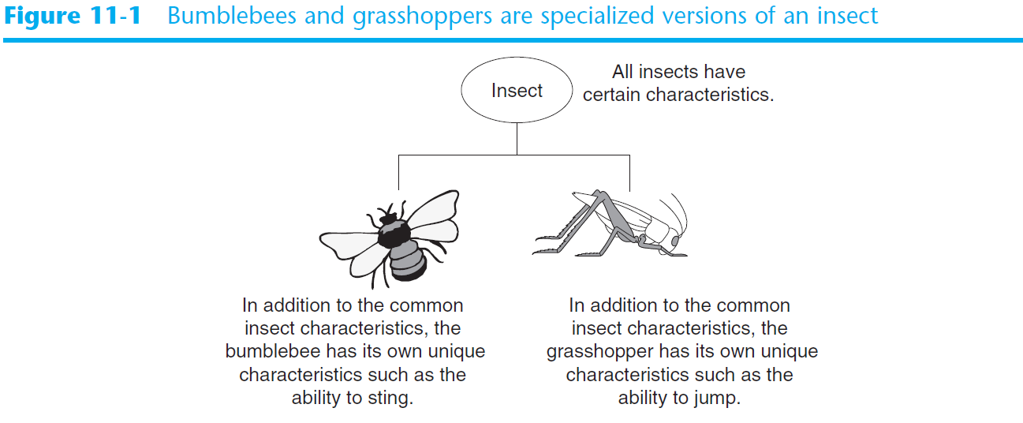
Introduction to Inheritance (cont’d.)

Slide 5
Inheritance and the “Is a” Relationship
“Is a” relationship: exists when one object is a specialized version of another object
Specialized object has all the characteristics of the general object plus unique characteristics
Example: Rectangle is a shape
Daisy is a flower

Slide 6
Inheritance and the “Is a” Relationship (cont’d.)
Inheritance: used to create an “is a” relationship between classes
Superclass (base class): a general class
Subclass (derived class): a specialized class
An extended version of the superclass
Inherits attributes and methods of the superclass
New attributes and methods can be added

Slide 7
Inheritance and the “Is a” Relationship (cont’d.)
For example, need to create classes for cars, pickup trucks, and SUVs
All are automobiles
Have a make, year model, mileage, and price
This can be the attributes for the base class
In addition:
Car has a number of doors
Pickup truck has a drive type
SUV has a passenger capacity

Slide 8
Inheritance and the “Is a” Relationship (cont’d.)
In a class definition for a subclass:
To indicate inheritance, the superclass name is placed in parentheses after subclass name
Example: class Car(Automobile):
The initializer method of a subclass calls the initializer method of the superclass and then initializes the unique data attributes
Add method definitions for unique methods

Slide 9
Inheritance in UML Diagrams
In UML diagram, show inheritance by drawing a line with an open arrowhead from subclass to superclass

Slide 10
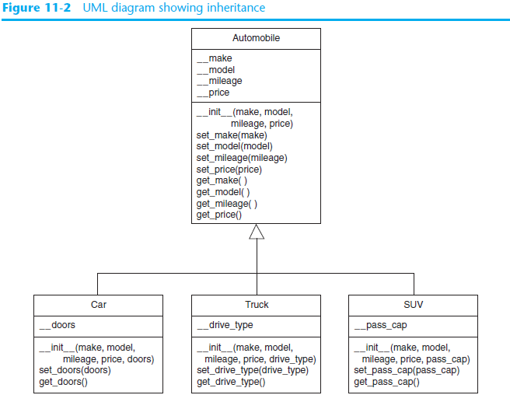

Slide 11
Polymorphism
Polymorphism: an object’s ability to take different forms
Essential ingredients of polymorphic behavior:
Ability to define a method in a superclass and override it in a subclass
Subclass defines method with the same name
Ability to call the correct version of overridden method depending on the type of object that called for it

Slide 12
Polymorphism (cont’d.)
In previous inheritance examples showed how to override the __init__ method
Called superclass __init__ method and then added onto that
The same can be done for any other method
The method can call the superclass equivalent and add to it, or do something completely different

Slide 13
The isinstance Function
Polymorphism provides great flexibility when designing programs
AttributeError exception: raised when a method is receives an object which is not an instance of the right class
isinstance function: determines whether object is an instance of a class
Format: isinstance(object, class)

Slide 14
Summary
This chapter covered:
Inheritance, including:
“Is a” relationships
Subclasses and superclasses
Defining subclasses and initializer methods
Depicting inheritance in UML diagrams
Polymorphism
The isinstance function

